Slide 1

Genetic Algorithm
Professor Bo Liu
James Watt School of Engineering

Slide 2
OUTLINE
Genetic Algorithm: A First Introduction
Genetic Algorithm: An Example
GA Representation, Initialization and Selection
GA Crossover and Mutation
GA Stopping Criterion and Summary
GA Working Flow, Main Components
GA Operator Design Principles
Use Genetic Algorithm via MATLAB: Employ the Function
Use Genetic Algorithm via MATLAB: Engineering Case Studies

Slide 3

Genetic Algorithm: A First Introduction

Slide 4
Overview of genetic algorithms
GA was developed in 1970s and is being widely applied.
There are many different versions nowadays, called genetic algorithms (GAs).
GAs are for solving optimization problems.
Easy to comprehend and apply,
Capable of solving some complex optimization problems,
Popular with the increase of computing power.

Slide 5
The intelligence to be borrowed
Computational intelligence (such as Neural Networks and Evolutionary Computation) builds problem solvers by copying ideas from God/nature
Brains → artificial neural networks
Evolution → evolutionary computation

Slide 6
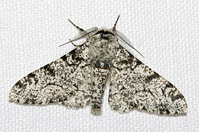
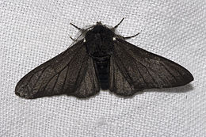
Manchester Moth Story
Before industrial revolution
After industrial revolution

Slide 7
Essential elements that can be extracted from “evolution”
Population
A number of individuals form a population.
Selection: Survival of the fittest
The better an individual is, the more possible it will become a parent for the next generation.
Crossover
The chromosome of a child is composed by chromosomes from its parents.
Mutation
In some occasions, some part of the chromosome can be randomly changed.

Slide 8
Use “evolution” to solve an optimization problem
A solution in the search space → an individual in natural evolution
We call it solution or individual or point
Evolution → “Create” better solutions.
Selection
A population of solutions
Mating pool (parent set)
Replacement
Crossover
Mutation
New solutions

Slide 9
Genetic Algorithm: An Example

Slide 10
How does GA solve an optimization problem?
An example
Consider the problem of maximizing the function
max G(x) = −(x−8)²+65
where x is an integer and can vary between 0 and 15.
Search Space: {0, 1, 2, …, 15}

Slide 11
How does GA solve an optimization problem?
Representing a solution (individual) by a binary string
x | 0 | 1 | 2 | 3 | 4 | 5 | 6 | 7
Binary Encoding | 0000 | 0001 | 0010 | 0011 | 0100 | 0101 | 0110 | 0111
x | 8 | 9 | 10 | 11 | 12 | 13 | 14 | 15
Binary Encoding | 1000 | 1001 | 1010 | 1011 | 1100 | 1101 | 1110 | 1111

Slide 12
How does GA solve an optimization problem?
Search Space
Initial Population
0101
1011
G(x) =56
0111
1011
1110
0010
0010
G(x) =29
0110
1111
0001
0011
1101
0001
G(x) =16
1000
0000
0000
0100
G(x) =1
1001
0011
1100
1010
Avg = 25.5
Selection
1 0 1 0
1 0 1 1
1 0 1 0
1 0 1 0
1 0 1 1
1011
mutate
crossover
1 0 1 1
0 0 1 1
0 0 1 0
0010
1011
0001
New Population
Mating Pool

Slide 13
How does GA solve an optimization problem?
Search Space
Initial Population
0101
1011
G(x) =56
0111
1011
1110
0010
0010
G(x) =29
0110
1111
0001
0011
1101
0001
G(x) =16
1000
0000
0000
0100
G(x) =1
1001
0011
1100
1010
Avg = 25.5
Selection
1 0 1 0
1 0 1 1
1 0 0 1
1 0 0 1
1 0 1 1
1011
1 0 0 1
0 1 1 1
mutate
crossover
0 1 1 1
0 0 1 1
0 0 0 1
0010
1011
0001
New Population
Mating Pool

Slide 14
How does GA solve an optimization problem?
Search Space
Current Population
0101
1 0 1 0
1 0 1 1
1 0 0 1
0 1 1 1
G(x) =61
0111
1011
1110
0010
G(x) =56
0110
1111
0001
0011
1101
G(x) =64
1000
0000
0100
G(x) =64
1001
0011
1100
1010
Avg = 61.25
Selection
1 0 1 1
0 1 1 1
1 0 1 0
1 0 0 1
1 0 0 1
0 1 1 1
1 0 1 1
1 0 1 1
1 0 1 0
mutate
crossover
0 1 1 1
0 1 1 0
0 1 1 1
New Population
Mating Pool

Slide 15
How does GA solve an optimization problem?
Search Space
Current Population
0101
1 0 1 0
1 0 1 1
1 0 0 1
0 1 1 1
G(x) =61
0111
1011
1110
0010
G(x) =56
0110
1111
0001
0011
1101
G(x) =64
1000
0000
0100
G(x) =64
1001
0011
1100
1010
Avg = 61.25
Selection
1 0 1 1
0 1 1 1
1 0 1 0
1 0 0 1
1 0 1 0
0 1 1 1
1 0 0 0
1 0 0 0
1 0 0 1
1 0 0 0
1 0 1 0
mutate
crossover
1 0 1 0
1 0 1 1
1 0 1 0
New Population
Mating Pool

Slide 16
How does GA solve an optimization problem?
Search Space
Current Population
0101
1 0 1 1
0 1 1 1
1 0 0 0
1 0 1 0
G(x) =56
0111
1011
1110
0010
G(x) =64
0110
1111
0001
0011
1101
G(x) =65
1000
0000
0100
G(x) =61
1001
0011
1100
1010
Avg = 61.5
The GA continues to produce new generations (population) of individuals until some stopping condition is met

Slide 17
The workflow of GA
Initialization
Selection
Crossover
Mutation
No
Replacement
Termination conditions?
Yes
Save the optimal solution

Slide 18
GA Representation, Initialization and Selection

Slide 19
The workflow of GA
Initialization
x ={x¹, …, x^{M}}
x_{mat}={x¹_{mat} , …, x^{M}_{mat}}
Selection
Crossover
x_{cross}={x¹_{cross} , …, x^{M}_{cross}}
Mutation
x_{mut}={x¹_{mut} , …, x^{M}_{mut}}
No
Replacement
Termination conditions?
Yes
Save the optimal solution

Slide 20
Representation
An individual is encoded with some data structure.
individual
Binary String:
0 0 1 1
gene
decoding
encoding
3
Other representations:
permutation, real number, integer, etc.
7 | 2 | 5 | 3 | 1 | 4 | 6

Slide 21
Initialization
GAs starts from an initial population:
A population = a set of individuals
Two essential things to be considered :
Population size: how many individuals?
The initialization method: how to obtain the initial population?
The initial population can be obtained by random sampling.
1000
0110
0101
0111

Slide 22
Selection
The selection strategy simulates the natural selection method: survival of the fittest.
decides which individuals go into the mating pool.
give more chances to better individuals.
determine “better” and “poorer” solutions by the fitness function.
Popular selection schemes: proportional selection, tournament selection, truncation selection

Slide 23
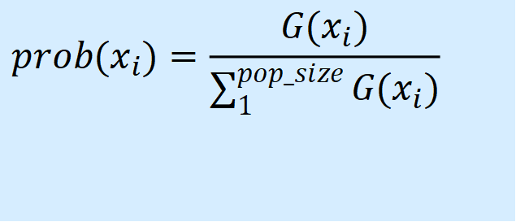
Selection
Proportional selection
Consider the problem of maximizing the function
max G(x) = −(x−8)²+65
where x is an integer and can vary between 0 and 15.
The probability of an individual becoming a parent
is proportional to its fitness
$$prob(x_{i})=\frac{G(x_{i})}{\sum_{1}^{pop_size}{G(x_{i})}}$$

Slide 24
Selection
Initial population (Generation 0) and corresponding fitness values:
i | chromosome x^{i} | G(x^{i}) | Prob(x^{i})
1 | 1011 | 56 | .55 | Maximum probability
2 | 0010 | 29 | .28
3 | 0001 | 16 | .16
4 | 0000 | 1 | .01 | Minimum probability

Slide 25
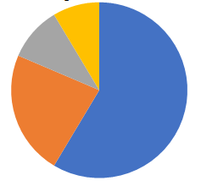
Selection
Roulette Wheel: implement proportional selection
Each individual occupies a part of the wheel with a size proportional to their fitness.
Turning the wheel allows for appropriate selection

Slide 26
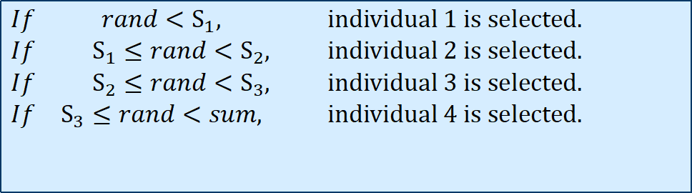
Selection
Roulette Wheel: implement proportional selection
Sum the fitness of all the population members: Sum (Sum=102)
Compute S₁= G₁, S₂= G₁ + G₂ , S₃= G₁ +G₂ + G_{3 ,} S₄= G₁ +G₂ +G₃ + G_{4.}
0 56 (S₁) 85 (S₂) 101 (S₃) 102 (S₄=Sum)
Generate a random number rand between 0 and Sum.
$$\begin{matrix}If & rand<S_{1}\text{, } & \text{individual}\text{ 1 }\text{is} \text{selected}\text{.} \\ If & S_{1}≤rand<S_{2}, & \text{individual}\text{ 2 }\text{is} \text{selected}\text{.} \\ If & S_{2}≤rand<S_{3}, & \text{individual}\text{ 3 }\text{is} \text{selected}\text{.} \\ If & S_{3}≤rand<sum\text{, } & \text{individual}\text{ 4 }\text{is} \text{selected}\text{.}\end{matrix}$$

Slide 27
Selection
Proportional Selection:
From population to mating pool
i | x^{i} | G(x^{i}) | Prob(x^{i}) | Mating Pool | G(x^{i})
1 | 1011 | 56 | .55 | 1011 | 56
2 | 0010 | 29 | .28 | 0010 | 29
3 | 0001 | 16 | .16 | 1011 | 56
4 | 0000 | 1 | .01 | 0001 | 16

Slide 28
Selection
The effect of selection:
Better individuals tend to have more copies in the mating pool.
Optimality | Mating pool > Previous Population | Selection guides the search into a promising area in the search space.
Diversity | Mating pool < Previous Population | Selection decreases the number of different candidates.

Slide 29
Selection
selection
Population
Mating
Pool
At last, all the members in the population will be same: the best one in the initial population.
Selection alone cannot solve the optimization problem.

Slide 30
GA Crossover and Mutation

Slide 31
The workflow of GA
Initialization
x ={x¹, …, x^{M}}
x_{mat}={x¹_{mat} , …, x^{M}_{mat}}
Selection
Crossover
x_{cross}={x¹_{cross} , …, x^{M}_{cross}}
Mutation
x_{mut}={x¹_{mut} , …, x^{M}_{mut}}
No
Replacement
Termination conditions?
Yes
Save the optimal solution

Slide 32
Crossover
New solutions are generated using the crossover and mutation operations.
These operators:
act directly on the individuals
are often used after selection
in most cases, have no relation with the fitness

Slide 33
Crossover
In crossover operation, two individuals crossover with each other in some way.
Simple (One-Point) Crossover
K-Point Crossover
Before crossover
After crossover
1 0 0 0
1 0 0 1
0 1 0 1
0 1 0 0

Slide 34
Crossover
Simple (One-Point) Crossover
Two individuals (parents) are selected randomly from the mating pool.
The crossover site is randomly selected.
The children are generated by swapping.
Crossover Site (4)
Parent 1
1 0 0 1 1 0
Child 1
1 0 0 1 0 1
Parent 2
0 0 1 0 0 1
Child 2
0 0 1 0 1 0

Slide 35
Crossover
K-Point Crossover
K-point crossover selects k crossover sites and swaps the substrings between them.
Example (K=2):
Crossover Site (2)
Crossover Site (4)
Parent 1
1 0 0 1 1 0
Child 1
1 0 1 0 1 0
Parent 2
0 0 1 0 0 1
Child 2
0 0 0 1 0 1

Slide 36
Crossover
Crossover rate
The two parents from the mating pool undergo crossover with a (usually high) probability, P_{c}.
A random number R_{c} is generated in the range of 0-1, and the individuals undergo crossover if R_{c} ≤ P_{c}
Otherwise, the parents proceed without crossover and directly become offspring.
Typical values of P_{c} are 0.6 to 0.9

Slide 37
Crossover
Generation 0
Generation 1
i | x^{i} | G(x^{i}) | Prob (x^{i}) | Mating Pool | G(x^{i}) | Crossover Site | x^{i}_{cross} | G(x^{i}_{cross})
1 | 1011 | 56 | .55 | 1011 | 56 | Rc ≤ Pc 2 | 1010 | 61
2 | 0010 | 29 | .28 | 0010 | 29 |  | 0011 | 40
3 | 0001 | 16 | .16 | 1011 | 56
4 | 0000 | 1 | .01 | 0001 | 16

Slide 38
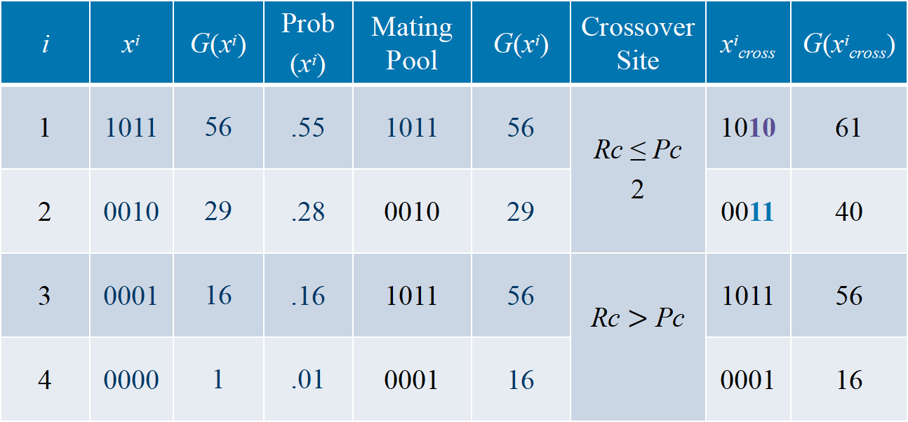
Crossover
Generation 0
Generation 1
i | x^{i} | G(x^{i}) | Prob (x^{i}) | Mating Pool | G(x^{i}) | Crossover Site | x^{i}_{cross} | G(x^{i}_{cross})
1 | 1011 | 56 | .55 | 1011 | 56 | Rc ≤ Pc 2 | 1010 | 61
2 | 0010 | 29 | .28 | 0010 | 29 |  | 0011 | 40
3 | 0001 | 16 | .16 | 1011 | 56 | Rc $>$ Pc | 1011 | 56
4 | 0000 | 1 | .01 | 0001 | 16 |  | 0001 | 16

Slide 39
Crossover
Effects of crossover
It may increase or decrease the average fitness with a limited number of samples.
Crossover increases diversity.
Mating Pool | G(x^{i}) | x^{i}_{cross} | G(x^{i}_{cross})
1011 | 56 | 1010 | 61
0010 | 29 | 0011 | 40
1011 | 56 | 1011 | 56
0001 | 16 | 0001 | 16

Slide 40
Crossover
Crossover & Premature Convergence
In some cases, crossover cannot generate new individuals, as shown below:
0 0 | 0 1
0 0 | 0 0
0 0 1 | 0
0 0 1 | 1
0 0 | 0 0
0 0 | 0 1
0 0 1 | 1
0 0 1 | 0
Selection + crossover cannot solve the problem on some occasions.

Slide 41
Mutation
After crossover, a gene mutation occurs in one of the individuals
A small probability to mutate (P_{m}≈ 0.01~0.001).
There are many mutation strategies.
In a binary string, with mutation rate, P_{m}, change a 0 to 1 or vice versa
Generating new individuals (guaranteed).

Slide 42
GA Stopping Criterion and Summary

Slide 43
The workflow of GA
Initialization
x ={x¹, …, x^{M}}
x_{mat}={x¹_{mat} , …, x^{M}_{mat}}
Selection
Crossover
x_{cross}={x¹_{cross} , …, x^{M}_{cross}}
Mutation
x_{mut}={x¹_{mut} , …, x^{M}_{mut}}
No
Replacement
Termination conditions?
Yes
Save the optimal solution

Slide 44
Stopping condition
If the stopping condition is not met, the GA continues to produce new generations.
Some stopping conditions:
Maximum number of generations
Satisfactory solution obtained
The population converges

Slide 45
Evolution mechanism
Crossover and mutation
Increase the population diversity
Has nothing to do with the fitness
Focus on generating new individuals
Selection
Decrease the population diversity
Increase the fitness
Focus on entering promising areas

Slide 46
Advantages and disadvantages of GAs
Advantages of GAs:
It is a general optimization method, which is independent of the problem domain.
The use of population; candidate solutions in a population can be evaluated in parallel.
It has the ability to generate various kinds of optimal solutions.
The process is not difficult to implement.

Slide 47
Advantages and disadvantages of GAs
Disadvantages of GAs:
It may not obtain a very high-quality optimal solution.
The algorithm has several parameters, and the selection of these parameters affects the quality of the solution.
It is not fast.

Slide 48
Design A GA

Slide 49
The Main Components of a GA
To build a GA, we should
Understand the problem we want to solve.
What is the Search Space, Any Constraints ?
How to measure the quality of a solution. Objective function or fitness value
Design a representation
Decide how to initialize a population
Design suitable mutation and crossover
Decide how to select individuals to be parents
Decide how to replace individuals in the old population
Decide when to stop the algorithm
{
modelling
Algorithm Design

Slide 50
GA Operator Design Principles

Slide 51
Representation
The principle:
The representation should depend on problem. The widely-used representations in GAs include:
Binary string (1, 0, 1, 1, 0, 1)
Popular in 1980 early 90’s. Not suitable for all the problems
Real vector (1.6, 1.44, -0.4, 5.99)
Suitable for continuous optimization problems
Permutation vector (4, 3, 1, 5, 6, 2)
Suitable for problems like TSP, QAP and n Queen Problem
Computer Program
Genetic Program (GP): search for a good program.
……..

Slide 52
Initialization
Uniformly (randomly) on the search space … if possible
Binary strings: 0 or 1 with probability 0.5
Real-valued representations: Uniformly on a given interval (OK for bounded values only)
Experimental Design Techniques
(Q. Zhang, Y. W. Leung, OGA for Routing Problem,
IEEE Trans on Evolutionary Computation, 1999)
Generate the first population based on problem-specific knowledge.
Principles:
As uniform as possible, and
Close to the optimal solution.

Slide 53
Mutation
Mutation operator: guarantee that each point of the search space could be visited.
The strength of mutation is important and should be controllable.
Mutation should produce valid solutions.
Average distance between the parent and the child

Slide 54
Example: Mutation for Binary Representation
Mutation usually happens with probability p_{m} (very small) for each position
parent
1 1 1 1 1 1 1
Child
1 0 1 0 1 1 1
Question: If P_{m} =1? What will happen?

Slide 55

Example: Mutation for real valued vector
$$\text{Parent} (x_{1}, x_{2}, x_{3}, x_{4}) \\ \text{Child} ( y_{1}, y_{2}, y_{3}, y_{4}) \\ \text{where} y_{i}=x_{i}+N(0,σ_{i}) (i=1,2,3,4) \\ N(0,σ_{i}): \text{a} \text{random} \text{number} \text{generated} \text{from} \text{normal} \text{distribution}\text{.}$$
$$\text{mean} \text{vaule} \text{is}\text{ 0, }\text{standard} \text{derviation} \text{is} σ_{i}. \\ \text{In} \text{MATLAB}\text{, }\text{randn} ()\text{, }\text{for} \text{details}\text{, }\text{please} \text{do} \\ \text{"}\text{help} \text{randn}()\text{" }\text{in} \text{Matlab} \text{or} \text{see} \text{help} \text{files}\text{. }$$

Slide 56
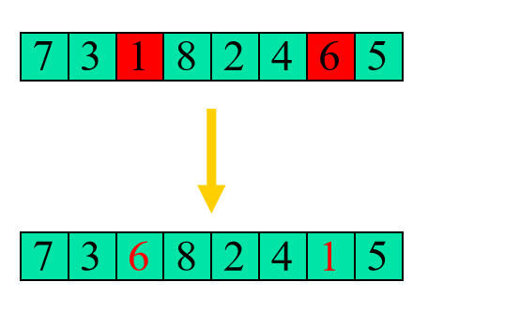
Example: Mutation for Permutation Vector (Swap)
Randomly select two different items and swap them.

Slide 57
Crossover Operators
The child should inherit something from each parent.
Crossover should produce valid solution.
Based on problem-specific knowledge if possible.

Slide 58
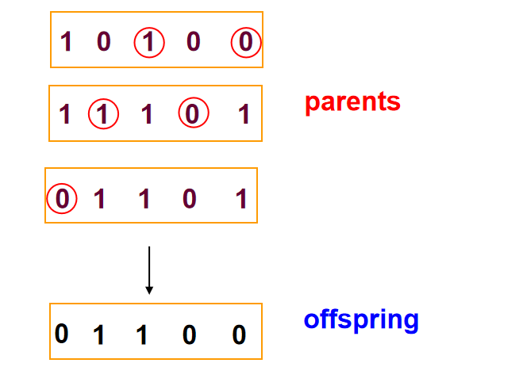
Example: crossover for Binary Representation
We have learned some crossovers. In the following, we give a m-parent crossover. How m parents generate one offspring! (m=3)

Slide 59
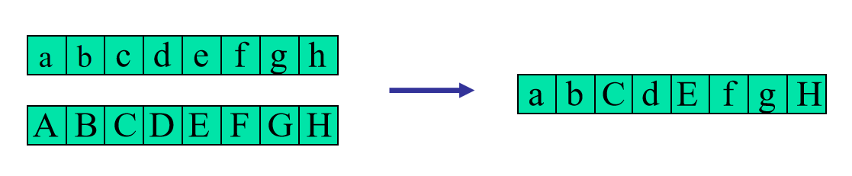
Example: Crossover for real valued representation
Uniform crossover: given two parents one child is created as follows

Slide 60
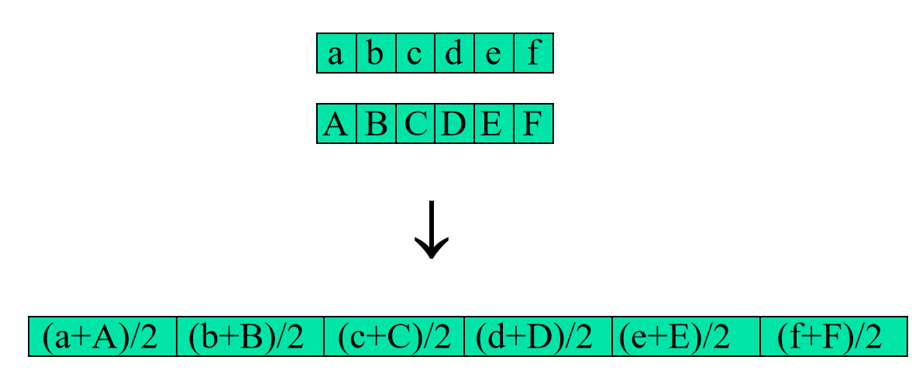
Example: crossover for real valued representation
Intermediate crossover (arithmetic crossover): given two parents one child is created as follows

Slide 61
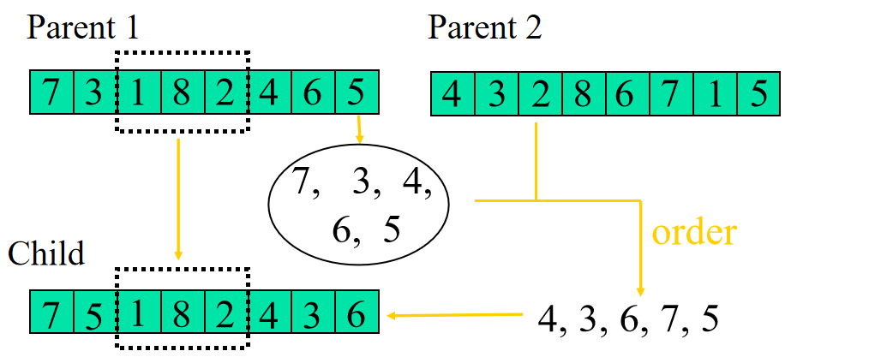
Example: Crossover for permutation (suitable for TSP)

Slide 62
Example: Crossover for permutation (suitable for TSP)
Choose an arbitrary part from the first parent and copy this to the first child
Copy the remaining items that are not in the copied part to the first child:
starting right from the cut point of the copied part
using the order of items from the second parent
wrapping around at the end of the permutation vector.
Repeat this process with the parent roles reversed

Slide 63
Selection
Better individuals have a better chance of being parents.
However, Don’t forget give poor individuals at least some chance of being parents – Poor individual may generate good offspring.

Slide 64
Example: Fitness proportional selection
If the size of mating pool=Pop_Size.
average number of the copies of f_{i} in mating pool is:

Slide 65
Example: Fitness proportional selection
Disadvantages:
Danger of premature convergence because outstanding individuals take over the entire population very quickly
e.g, f(x1)=1000, f(x2)=0.01, f(x3)=0.002,
prob(x1)=1, prob(x2)=0, prob(x3)=0,
Low selection pressure when fitness values are near each other
e.g, f(x1)=1000, f(x2)=999, f(x3)=987,
prob(x1)=prob(x2)=prob(x3)=1/3,

Slide 66
Example: Fitness proportional selection
Fitness scaling before proportional selection
Change the fitness. But make sure that
The poor is still poor and the rich is still rich.
Fitness should >0.
If you want to increase the chance for the poor. Decrease the (relative) gap between poor and rich
If you want to decrease the chance for the poor. Increase the gap.

Slide 67
Example: Rank based selection
Fitness: f(A) = 22, f(B) = 200, f(C) = 19
Rank: r(A) = 2, r(B) = 3, r(C) = 1
New Fitness f_{new}(A)=2, f_{new}(B)=3, f_{new}(C)=1,
Based on new fitness do proportional selection

Slide 68
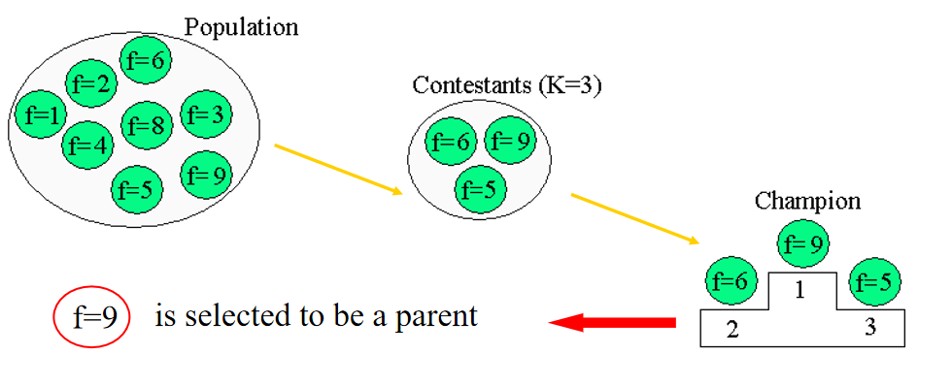
Example: Tournament selection
Randomly select k individuals from the current population.
Take the best
k is called the size of the tournament

Slide 69
Replacement Scheme
Full replacement
The offspring fully replace the old population. All the old member are deleted (e.g. the example in GA 1)
Partial replacement
Offspring compete with Parents, the better ones become new members in the new generation.

Slide 70
Stopping condition
The optimum is reached!
Limit on CPU resources. Maximum number of fitness evaluations
Limit on the user’s patience. After some generations without improvement

Slide 71
Exploration vs Exploitation
Exploration =sample unknown regions
Too much exploration = random search, no convergence
Crossover mainly for Exploration.
Exploitation = Focus on the best area found so far
Too much exploitation = local search only … convergence to a local optimum
Selection mainly for Exploitation.
How about mutation?

Slide 72
Use Genetic Algorithm via MATLAB: Employ the Function

Slide 73
Mathematical benchmark problems
Mathematical benchmark problems are used to test the performance of an algorithm before using it to engineering problems.
Problems with various characteristics (unimodal, multimodal, many variables, various shape, etc.).
The global optimum/Pareto front is often known.
They are often computationally cheap.
There are reference performances of various algorithms for them in the literature to be compared with.

Slide 74
Mathematical benchmark problems (hyperlinks)
Optimization test problems source 1
Global optimization test problems source 2
Test problems in IEEE Congress on Evolutionary computation 2009

Slide 75
Pros and cons of benchmark problems
Provide a quick evaluation of an algorithm.
Have various shapes and characteristics and have similarity with particular engineering problems.
Often, they are not generated from engineering problems.

Slide 76
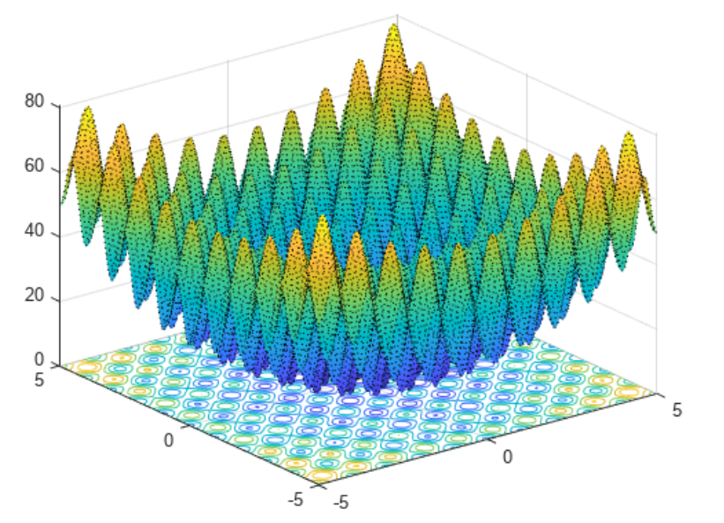
An example benchmark function
An example benchmark function: Rastrigin function​
2D-Rastrigin function

Slide 77
Rastrigin function
where d is the dimension of x.
Description:
many local minimum
one global minimum
Global Minimum: f(x*)=0, x*=[0,…,0]

Slide 78
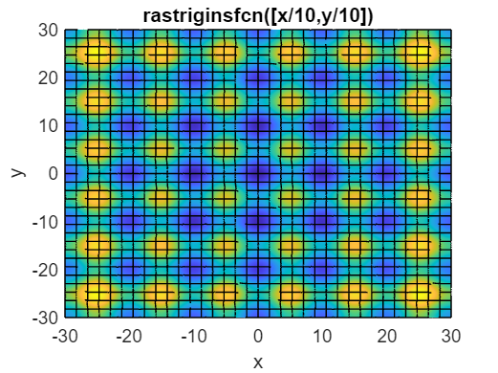

Use GA to solve benchmark problems
rng default % For reproducibility
x = ga(@rastr_fx,2)
This solution ( ) has some distance to the true minimum ( ).

Slide 79

Use GA to solve benchmark problems
rng default % For reproducibility
x = ga(@rastr_fx,2,[],[],[],[],[-5 -5],[5 5])
This solution ( ) is very near to the true minimum ( ).

Slide 80
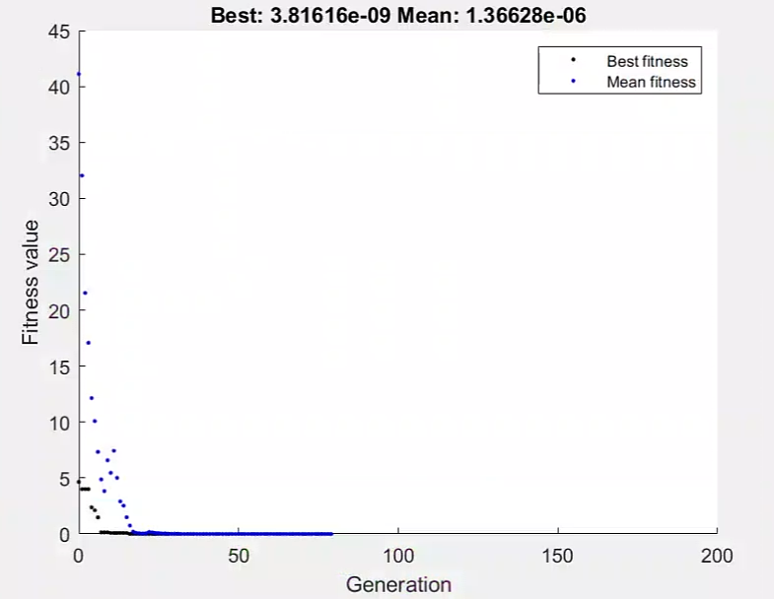
Use GA to solve benchmark problems
rng default % For reproducibility
options = optimoptions('ga','PlotFcn', @gaplotbestf);
x = ga(@rastr_fx,2,[],[],[],[],[-5 -5],[5 5],[],options)
This solution is very near to the true minimum.

Slide 81

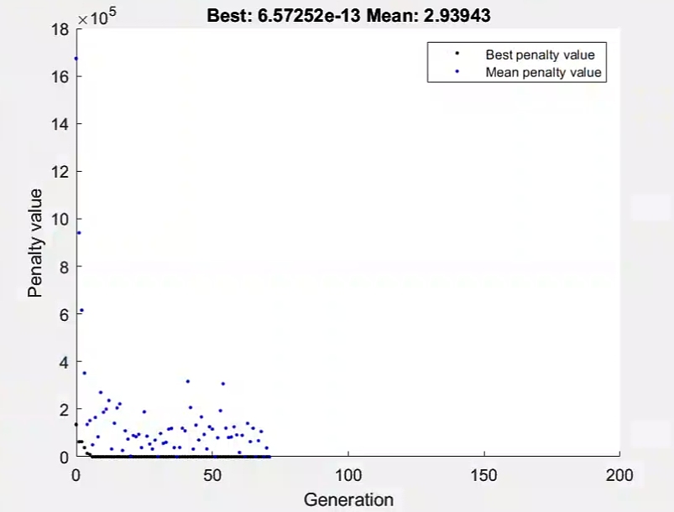
Use GA to solve benchmark problems
rng default % For reproducibility
options = optimoptions('ga','PlotFcn', @gaplotbestf);
x = ga(@rastr_fx,2,[],[],[],[],[-5 -5],[1500 1500],[],[1],options)
This solution is very near to the true minimum.

Slide 82
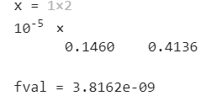
Use GA to solve benchmark problems
rng default % For reproducibility
options = optimoptions('ga','PlotFcn', @gaplotbestf);
[x fval]= ga(@rastr_fx,2,[],[],[],[],[-5 -5],[5 5],[],options)
This solution is very near to the true minimum.

Slide 83
Use Genetic Algorithm via MATLAB: Engineering Case Studies

Slide 84
Antenna design problem
Problem description
Dipole antenna
The geometry parameters [l, r] determine the performance of the antenna.

Slide 85
Antenna design problem
Problem description:
Dipole antenna: center frequency at 2 GHz.
Design requirements:
the magnitude of the S₁₁ is less than -10 dB within the frequency range [1.8 GHz 2.2 GHz].
l is between 60 mm and 90 mm.
r is between 0.1 mm and 0.5 mm.

Slide 86
Antenna design problem
Optimization problem formulation
minimize
f_{i}∈[1.8GHz 2.2GHz]
x=[l, r]
l∈[60mm 90mm]
r∈[0.1mm 0.5mm]
f_{i} is the ith frequency sample in the frequency band.
K is the number of samples in frequency band.
|·|* is defined as summing the number of frequency points whose values of is above -10dB.

Slide 87
Formulate the objective function in MATLAB
function y=func_antenna(x)
fre=2*1e9;% Set center operating frequency (Hz)
subobject=design(dipole,fre);% Create antenna type: dipole
subobject.Load.Impedance=100;% Set excitation port impedance
% S Set antenna size
subobject.Length=x(1);
subobject.Width=x(2);
S_data=sparameters(subobject,1*1e9:2e7:3*1e9,201); % S parameter calculation
y=sum((mag2db(abs(S_data.Parameters(1,1,41:61)))>-10));
figure(1);h=rfplot(S_data);
end
Design parameters
Objective function
https://uk.mathworks.com/videos/designing-antennas-and-antenna-arrays-with-matlab-and-antenna-to-1483477877085.html

Slide 88
Perform GA for finding the optimal design
clear all;
clc;
rng default
options = optimoptions('ga','PlotFcn', @gaplotbestf,'PopulationSize',10,'MaxGenerations',25);
[x]= ga(@func_antenna,2,[],[],[],[],[60/1000 0.1/1000],[90/1000 0.5/1000], [],options)
Output
Design parameter bounds

Slide 89
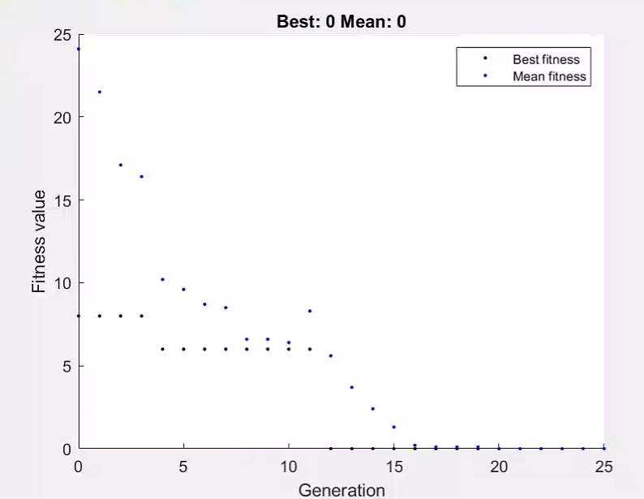
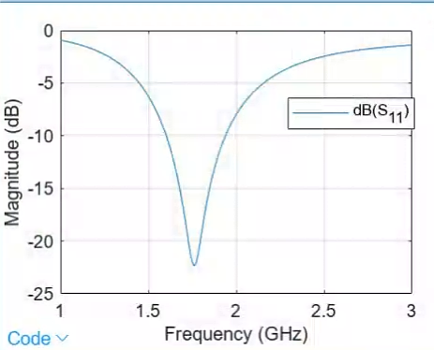
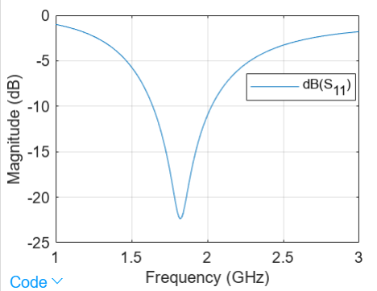
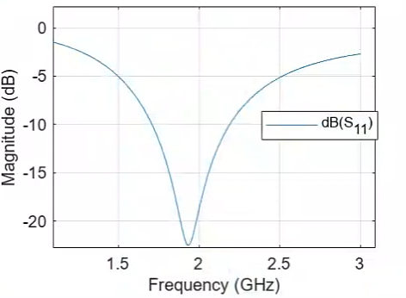
Perform GA for finding the optimal design
Optimization process
This solution meets design requirements.

Slide 90
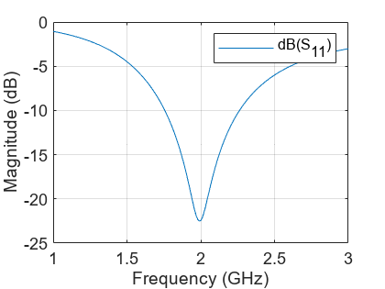

Perform GA for finding the optimal design
Optimization results

Slide 91
Perform GA for finding the optimal design and the objective function value
clear all;
clc;
rng default
options = optimoptions('ga','PlotFcn', @gaplotbestf,'PopulationSize',10,'MaxGenerations',25);
[x fval]= ga(@func_antenna,2,[],[],[],[],[60/1000 0.1/1000],[90/1000 0.5/1000], [],options)
Output

Slide 92
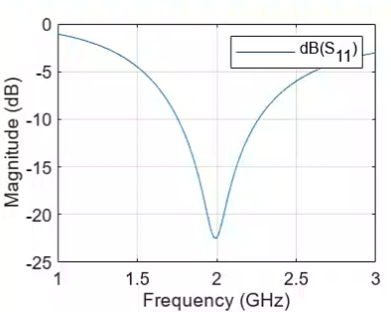

Perform GA for finding the optimal design and the objective function value
Optimization results

Slide 93




Thanks!
#UofGWorldChangers
@UofGlasgow

